Slide 1

Plant Pals
Customer Survey Results
Shipped test batches to 50 customers to collect survey on 4 points over a period of 4 weeks. The goal was to identify early the potential issues before official launch.

Slide 2
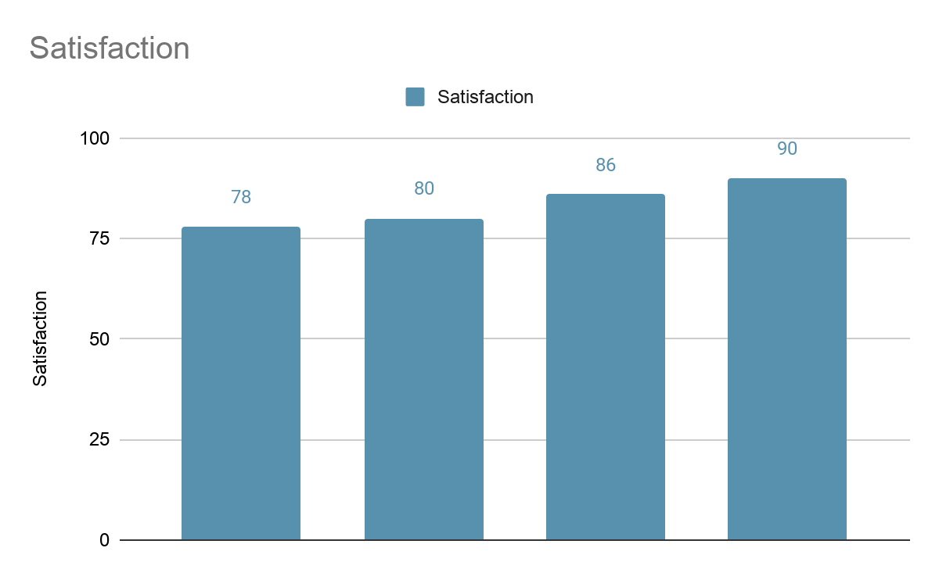
Did your shipment arrive on time?
[Insert chart or graph here]
Key takeaways & action items:satisfaction percentage grew each week up to 90% after week 4

Slide 3
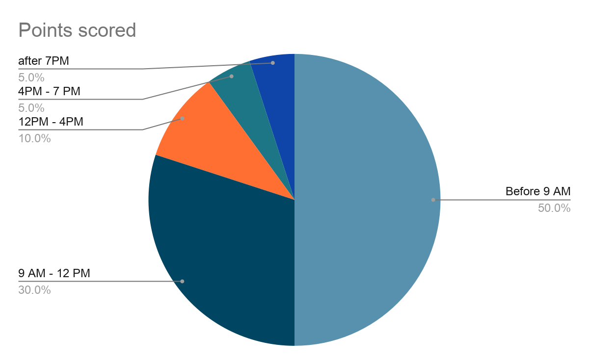
What is your preferred time of day to receive a shipment from Plant Pals?
[Insert chart or graph here]
Key takeaways & action items: 50% prefer to get delivery before 9AM, 30% between 9AM and 12PM

Slide 4
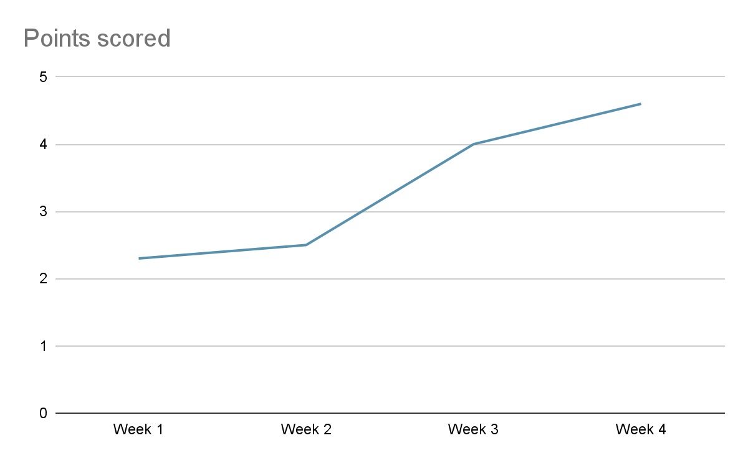
On a scale of 1 to 5, with 1 being the lowest and 5 being the highest, how satisfied are you with customer support?
[Insert chart or graph here]
Key takeaways & action items: Customer satisfaction rate grey to 4.6 after week 4

Slide 5
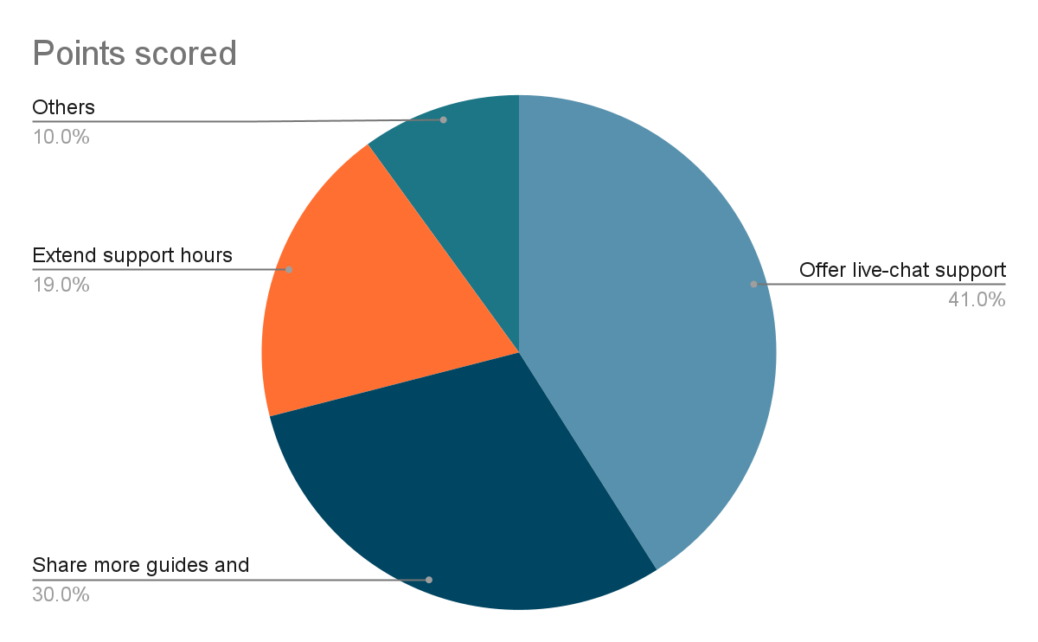
In general, how do you suggest we improve our customer support?
[Insert chart or graph here]
Key takeaways & action items: Lot of customers want live-chat support, and guides and tutorials

Slide 6
Conclusion and next steps
To address the issues reported, after week 2 we worked on some items, for example we hired more drivers, and reassessed the delivery routes, and as we can see in the slide 2, over 4 weeks, 90% of customers said it was delivered on time, up from 78%.
Also we started to send newsletters via email, containing guides and tutorials on how to take care of their plants.
Based on preferred delivery time survey, we noticed that 50% of customers prefer to receive delivery before 9AM, with this, we can focus on offering more work hours to our drivers in the morning to offer more delivery slots in this time frame.
Also to offer 24/7 customer support, we could train an AI chat bot, that has a huge knowledge base about all plants we have, and how to maintain them, and other general stuff too like how we operate, all our services, products, and how-to questions.

